Slide 1
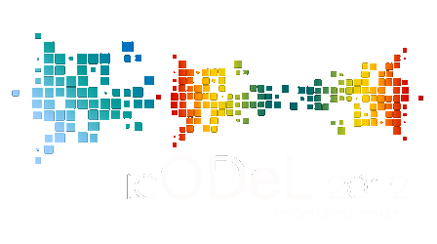
Translocal Assessment Competencies: Using a Proficiency-based Learning Management System
by
Noel R. Buensuceso
Associate Professor, Miriam College, Philippines
and
Joel C. Yuvienco
Edu 2.0 Country Representative, Philippines

Slide 2
Outline of Presentation
Introduction
Challenges and Opportunities of Learning Assessment
Demonstration of Proficiency-based Learning Management System
Conclusions and Recommendations

Slide 3
Introduction
This paper explores the opportunities and challenges of learning assessment where the current learner population lives in a globally- connected generation that is increasingly marked by mobility across regional boundaries.
In particular, the paper will demonstrate the use of evidence-based assessment tools that transcend global standards using a Proficiency-based Learning Management System.

Slide 4
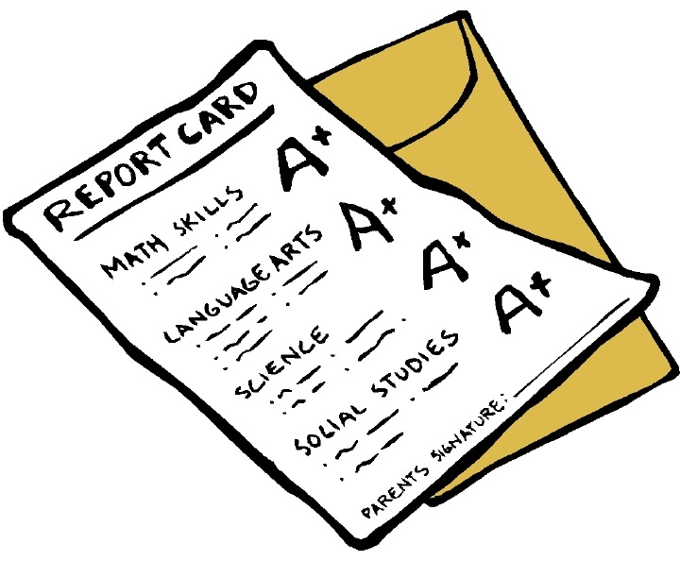
Challenges of Learning Assessment
What happens when a student leaves school? Transfers? Is employed?
A = Average?

Slide 5
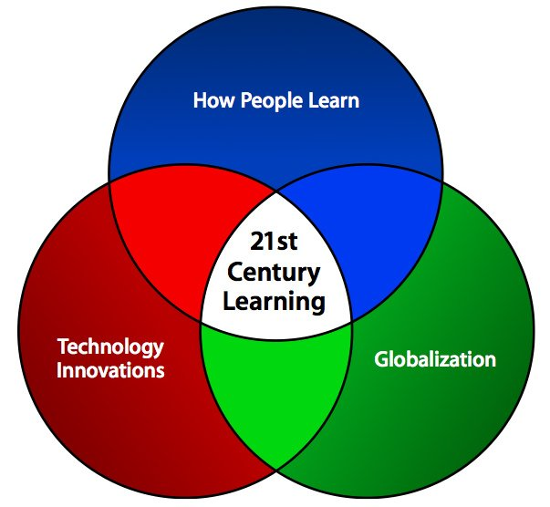
Challenges of Learning Assessment
How does a particular assessment record transcend
boundaries of time and space?
Translocal: Putting local issues in the global context and making it widely accessible.“ ( Ewa Wojtowicz, 2002)

Slide 6
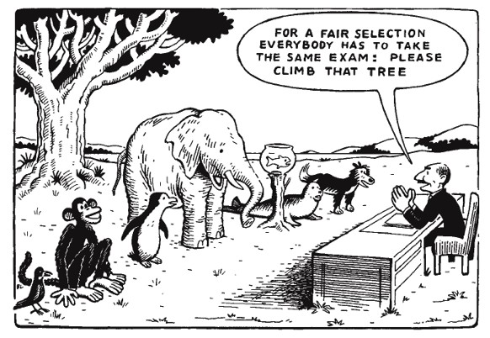
Challenges of Learning Assessment
Proof of learning achievement is still dominated by assessment
of learning via standardized or departmental ( or norm-
referenced ) tests.

Slide 7
Opportunities
In Australia, for example, as early as 2007, there was
already “a groundswell of interest and activity around
ePortfolios in Universities.” ( Lambert and Corrin, 2007)

Slide 8
Opportunities
Online or ICT approached
Blended in-person and ICT mediated assessment
Learning Management Systems

Slide 9
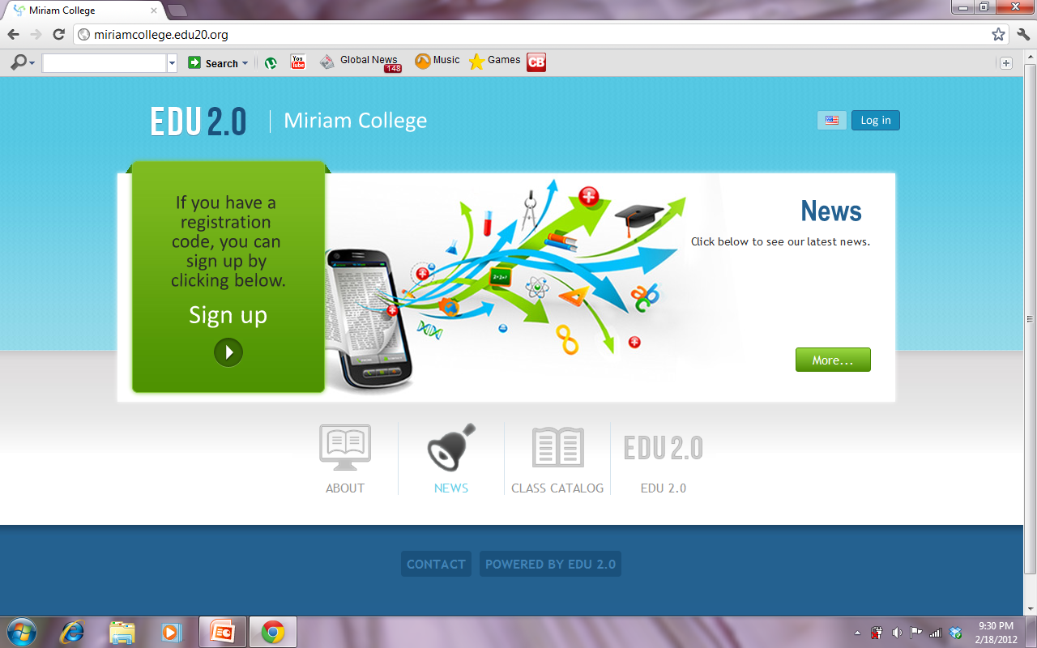
Edu 2.0

Slide 10
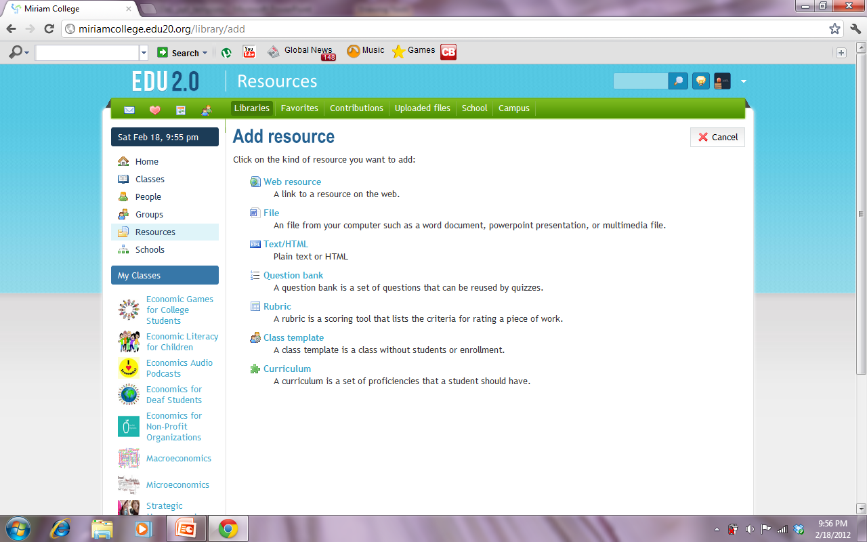
Curriculum
Curriculum is a set of proficiencies that a student should have.
Having a curriculum as a resource is essential in keeping the objective of
learning in place.
This component allows for the LMS to provide some sort of learning compass.

Slide 11
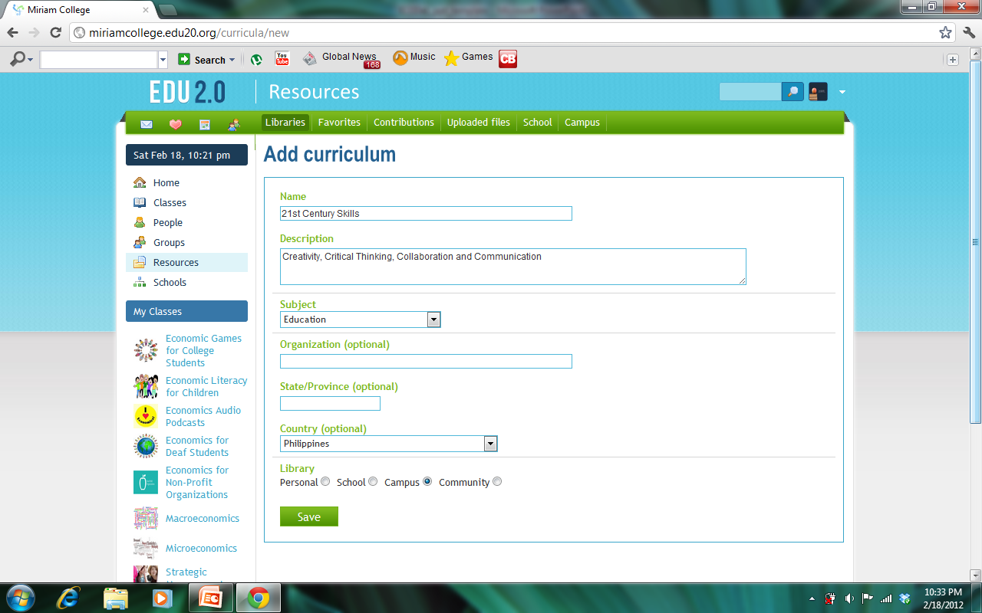
Curriculum plotted on Edu 2.0
Curriculum is not complete without a reference to its sub-components, in the form of proficiencies or competencies that a learner is expected to possess at the end or upon successful completion of a course or subject.

Slide 12
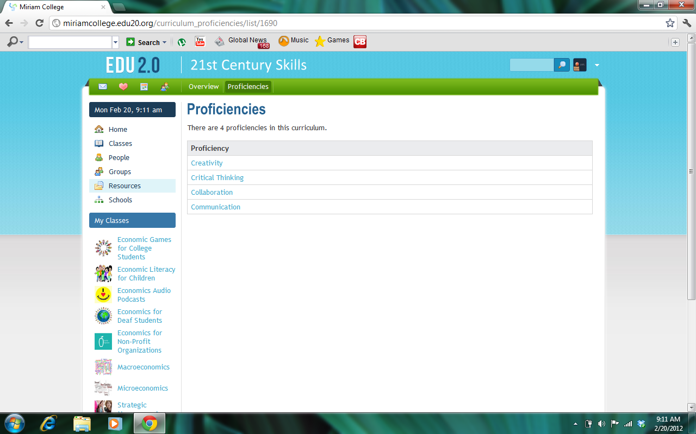
Details of a Curriculum
The figure shows the details of a curriculum, i.e., 21st Century Skills
comprising of Creativity, Critical Thinking, Collaboration, and Communication.

Slide 13
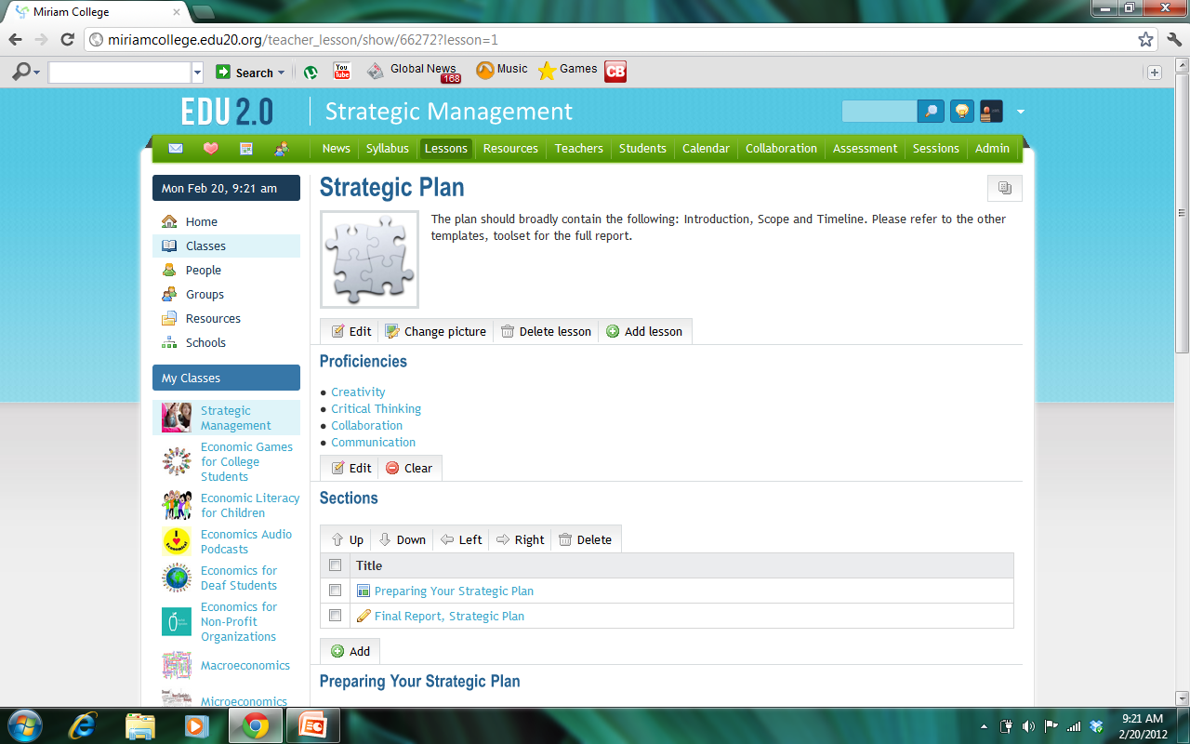
A Proficiency-tagged Lesson
The lesson ( Strategic Plan ) above is considered as a Proficiency-tagged lesson. The first two layers of mapping a Curriculum to a course. This means that the topic or lesson is associated with all four proficiencies in the proficiency map.

Slide 14
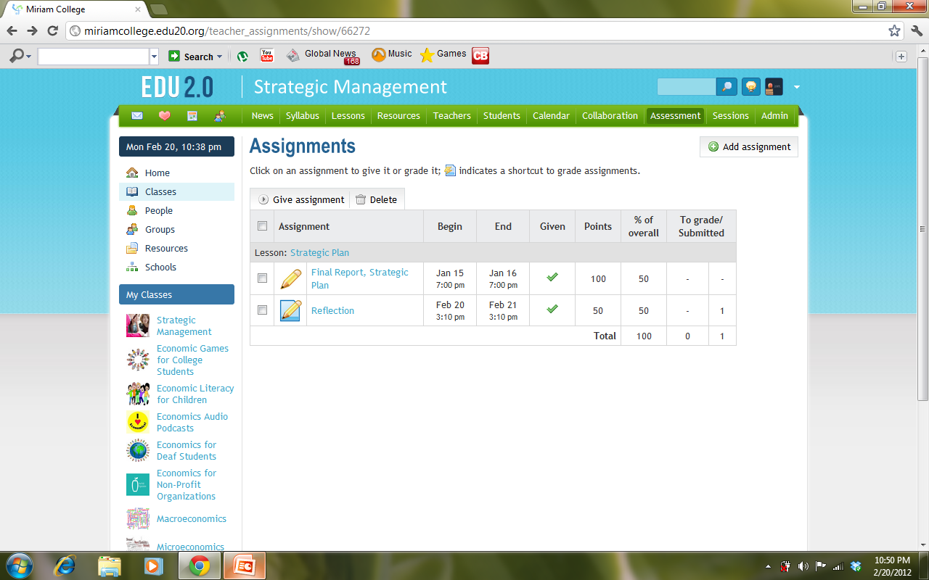
A Proficiency-tagged Assignment
The previous figure and the figure above together demonstrate the second layer of mapping a curriculum to a course, i.e. via proficiency-tagged assignment.

Slide 15
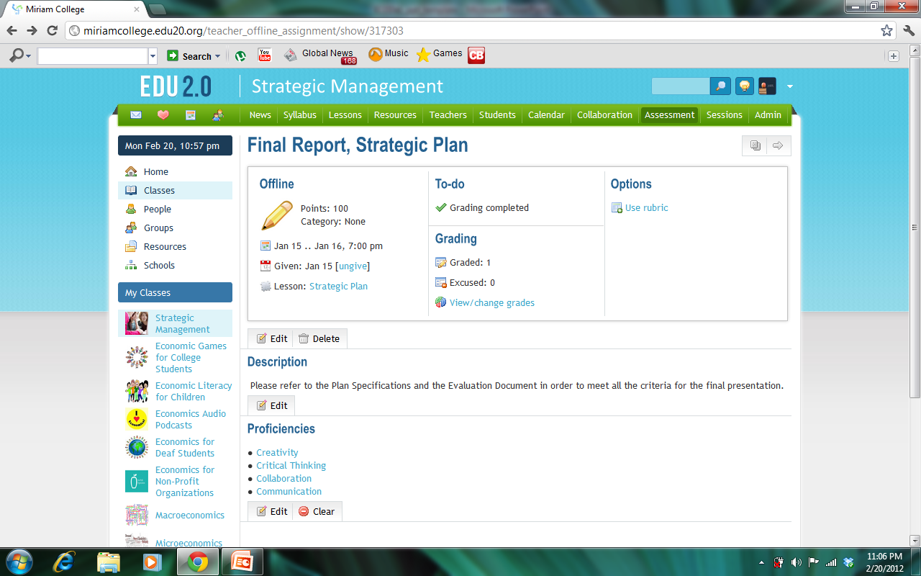
Rubrics
It may be noted that criterion-referenced assessment is usually done using rubrics. The figure above shows an option to integrate and program a suitable set of rubrics.

Slide 16
Proficiency Map
A proficiency map is not just a list of to-dos for purposes of identifying expected learning outcomes.
Thus, it is necessary for a teacher doing assessment to have access to an analytical tool to show extent of curriculum coverage from both the teaching ( delivering lessons ) to measuring the learner’s
acquisition or production of new knowledge.

Slide 17
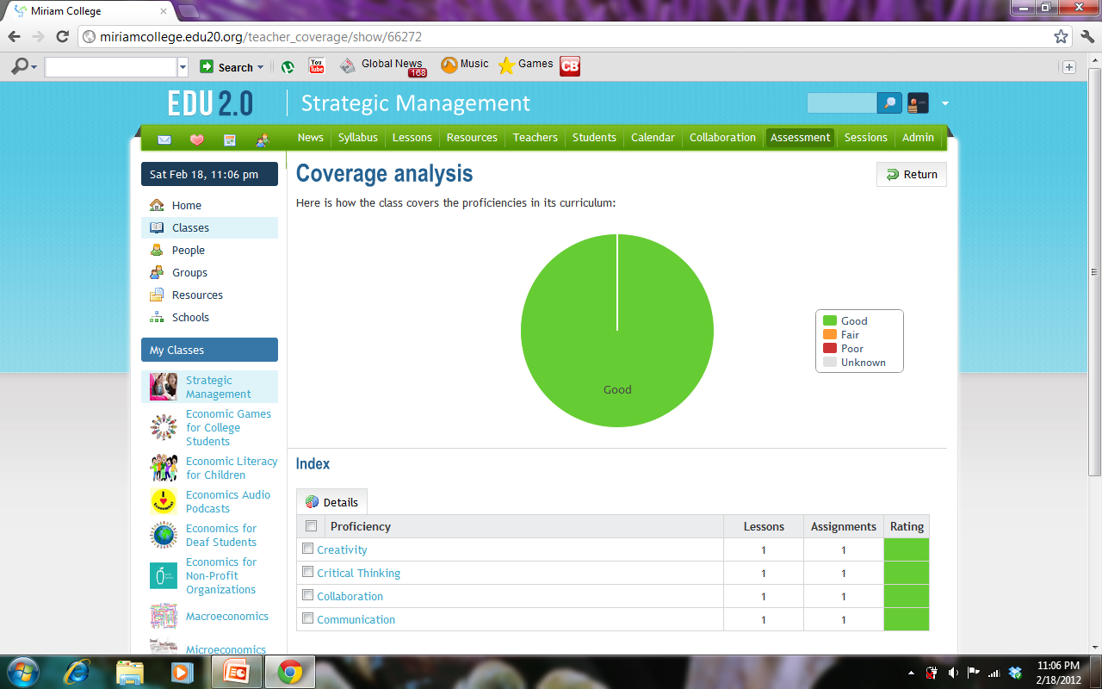
Proficiency Coverage
Color green- whenever a lesson has ( or lessons have ) both been taught and assessed
Color yellow- if a lesson has ( or lessons have ) been taught but not assessed
Color red- when lesson has ( lessons have ) been assessed but not taught
Color white- unknown

Slide 18
Conclusion and Recommendations
The given framework and processes discussed demonstrates that mapping a curriculum with its set of proficiencies to a course syllabus with its lessons, resources, and assessments could provide a mechanism for what could be called a “ Proficiency Accountability.”
Apart from the benefit of accountability to all learning stakeholders, e.g., learner, parents, teachers, school administration, a proficiency-based LMS also promotes transparency of the assessment processes.

Slide 19
Conclusion and Recommendations
The challenge is finding the right-mix of traditional and ICT-enabled assessment
In the context of education reform, this rather complex approach of proficiency –based assessment, being data-driven, could help inform policy makers.
Continuous professional development training especially on rapidly evolving technologies for education is encouraged.

Slide 20
Thank you!
Noel R. Buensuceso
noel.buensuceso@gmail.com
Joel C. Yuvienco
joel.yuvienco@gmail.com

